Slide 1

Smart Study Material Organizer
Team Name : MindCrafters

Slide 2

Introduction
AI-driven document organization automates handling of study materials by using machine learning (ML) for OCR and NLP .
Optical Character Recognition (OCR) and Natural Language Processing (NLP) enable automatic text and keyword extraction from documents.
Cloud-based solutions (e.g., AWS Textract, Comprehend) allow scalable processing of large document collections and eliminate manual indexing.

Slide 3

AIM and Objectives of the Project
Goal: Automate organization and keyword extraction from study PDFs using AWS services .
Use Amazon Textract to extract text from uploaded PDF documents .
Use Amazon Comprehend to extract key phrases and entities from the extracted text . Store extracted content and metadata in AWS S3 and DynamoDB for indexing and search.
Provide a user interface for keyword-based search of organized study materials.

Slide 4

Existing System Challenges
Students currently organize PDFs manually (e.g., by folders, filenames, personal notes).
No automated indexing or full-text search; finding information relies on manual lookup.
Manual document processing is labor-intensive and error-prone .
Existing approach does not scale well and makes retrieval of relevant content difficult.

Slide 5
Proposed Work
Architecture: Our proposed pipeline uses AWS cloud services to automate document processing. PDF uploads trigger Amazon Textract to extract text, then Amazon Comprehend to extract key phrases. Extracted data are stored in Amazon S3 and DynamoDB for indexing .
Steps: Users upload study PDFs to a web interface (stored in S3).
AWS Lambda is triggered by the upload, invoking Amazon Textract for OCR on the PDF.
The extracted text is sent to Amazon Comprehend for keyword/entity extraction.
Results (full text and keywords) are saved in AWS S3 and DynamoDB.
A web-based Search UI queries DynamoDB to retrieve documents matching keyword queries.

Slide 6
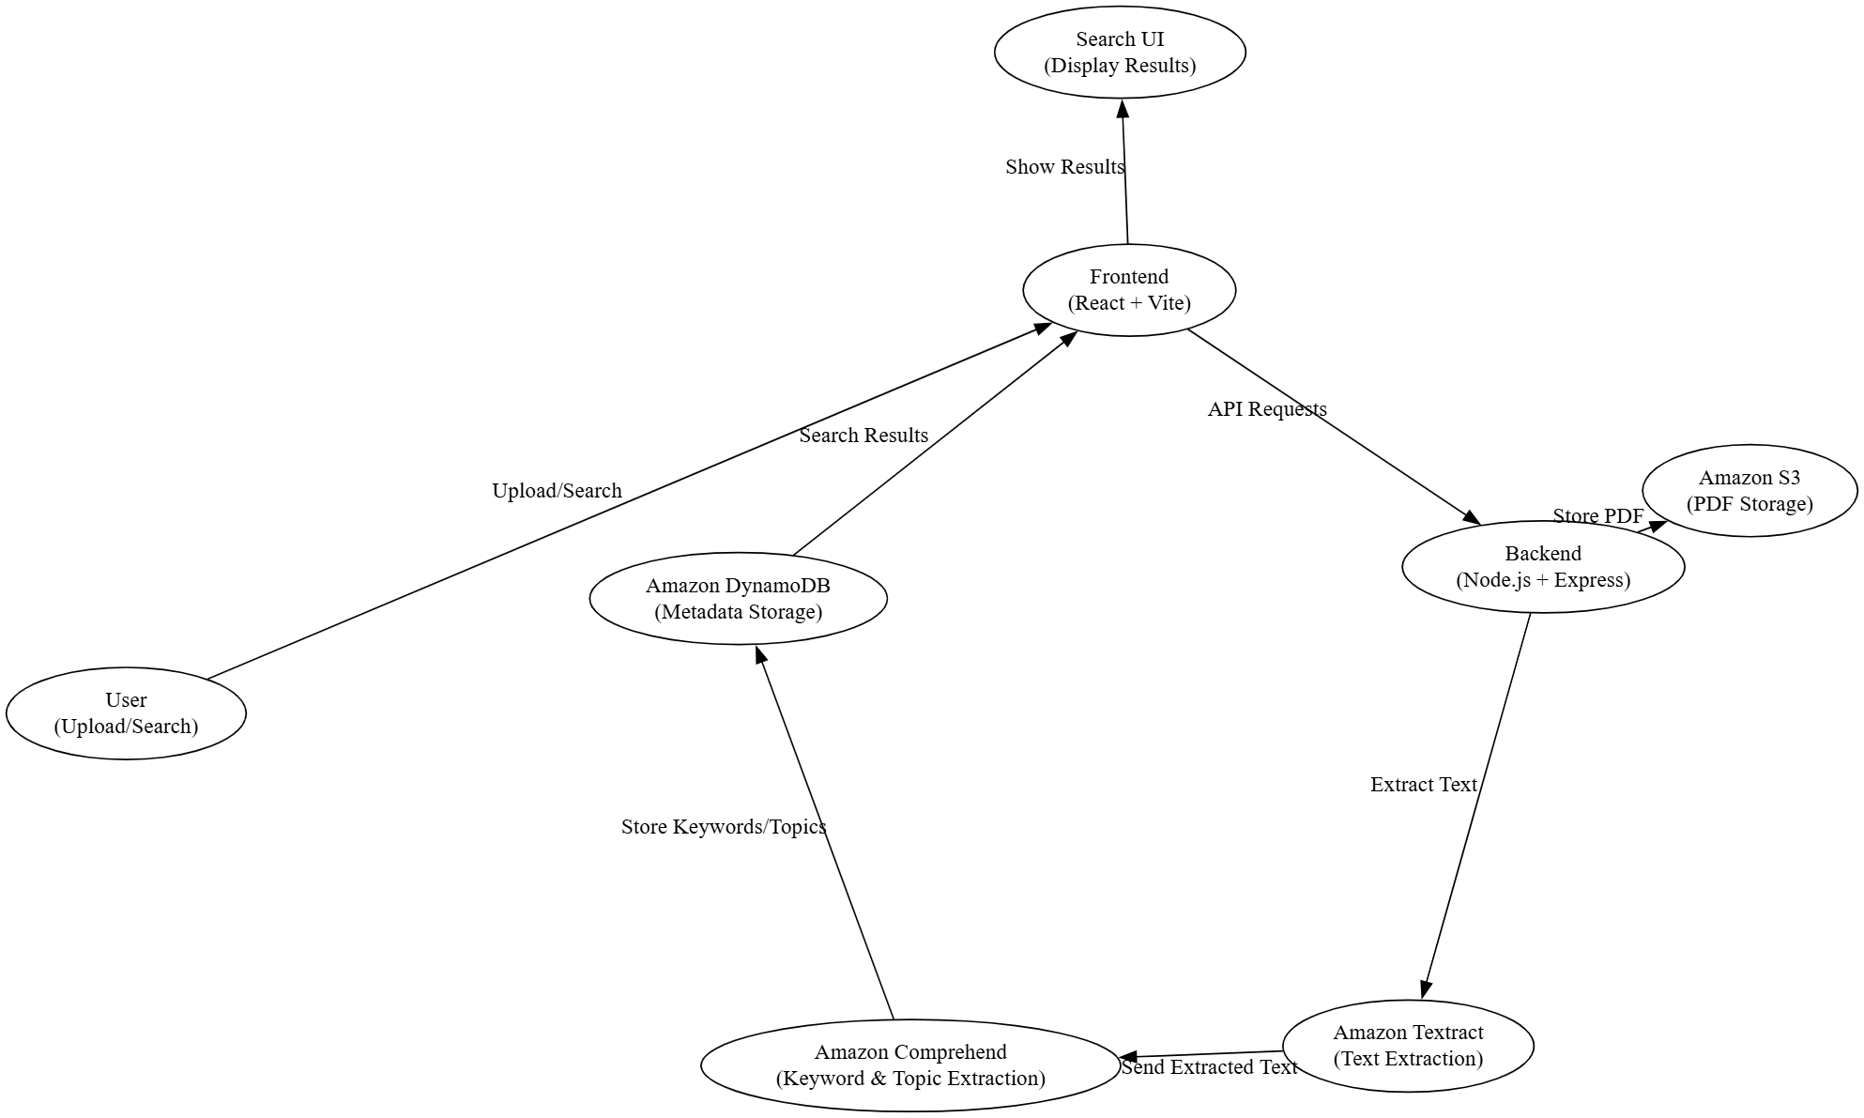
Block Diagram

Slide 7

Drawbacks of Existing System
Slow and inconsistent document management.
No keyword indexing; students must recall exact file names or content.
Manual retrieval increases chances of errors and missed information.
Proposed AI-driven solution automates indexing and search, improving speed, accuracy, and scalability.

Slide 8
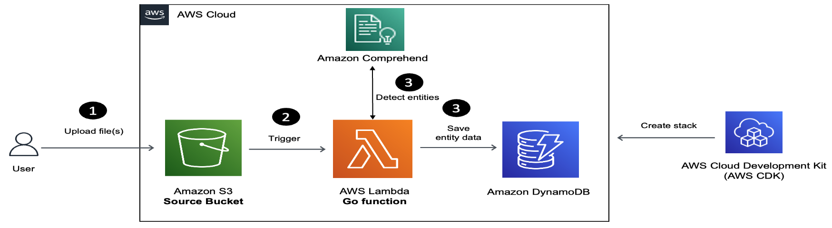
AWS Components Used in the System
Amazon Textract: ML-powered OCR service for extracting text from documents .
Amazon Comprehend: NLP service for extracting key phrases, entities, and sentiment from text .
Amazon S3: Scalable object storage for storing uploaded PDFs and processed results.
Amazon DynamoDB: NoSQL database for storing document metadata and extracted keywords for fast lookup.
AWS IAM: Manages authentication and fine-grained permissions for users and services.

Slide 9

Demonstration and Workflow of the Solution
Upload a sample PDF via the application interface (document stored in an S3 bucket).
The upload triggers AWS Lambda, which invokes Amazon Textract to extract text from the PDF .
Textract output is passed to Amazon Comprehend for key phrase and entity extraction.
Extracted keywords and document text are indexed in DynamoDB.
User enters a keyword query in the Search UI; the system queries DynamoDB and returns relevant documents.

Slide 10

Conclusions
The AI-driven solution eliminates manual indexing, saving time and reducing errors .
Students can quickly find and access relevant study materials through keyword search instead of manual lookup.
The system is highly scalable (cloud-based) and easily extensible (e.g., future summarization or multilingual support).
AWS ML services enable processing documents “in minutes instead of hours” with high accuracy (Textract outperforms traditional OCR ).
Future Scope: Extend support to more file types, add advanced analytics (topic modeling, summarization), and integrate additional AI features.

Slide 11

Refrences
Amazon Textract – AWS service overview .
Amazon Comprehend – AWS NLP service documentation .
AWS Intelligent Document Processing (IDP) overview .
AWS Blog: “Building an NLP-powered search index with Textract and Comprehend” .
Sadek, J. Leveraging OCR and HTR Cloud Services Towards Data Extraction and Analysis. Springer, 2024.
Şahin et al. (2025), “LitOrganizer: Automating data extraction and organization for scientific literature reviews” (SoftwareX) .
Hegghammer (2021), “OCR with Tesseract, Amazon Textract, and Google Document AI: a benchmarking experiment” (J. Comput. Soc. Sci.) .
Wu et al. (2007), “Machine learning-based keywords extraction for scientific literature” (J. Universal Computer Sci.)

